Slide 1
FullStack-II Project Presentation
Project Name: “Picsgram- An Image uploader”
Submitted To: Mr. Pankaj Kapoor Made by: Gauri Agrawal
Nidhi Jain
Radhika Bansal
Sakshi Bhardwaj

Slide 2
Objective
We have created a React based Application.
We are creating an image uploading and viewing application in which user can:
Upload an image of one’s own choice and displaying the preview of the image before uploading.
Getting the notification of successfully uploading the image.
Viewing all the uploaded images in the gallery section.
We have created an eye-captivative user interface with soothing color and textures.
Our objective is to create an uploader and a gallery viewer using the backend technologies which can be the major part of our life and can be taken to a large scale in future.

Slide 3
Motivation
For any developer who envisions building an application, uploading images is a major component they have to take into account.
It is an essential requirement while creating a complete application.
File uploading means a user from a client machine wants to upload files to the server. For example, users can upload images, videos, etc on Facebook, Instagram.
This application will also help the designers, the illustrators and the photographers to get motivation and also fulfill their need where photographers can showcase their skills by uploading the pictures and reaching to a large public, whereas, these pictures can be used by the designers and illustrators in their projects and they can get an idea from them.

Slide 4
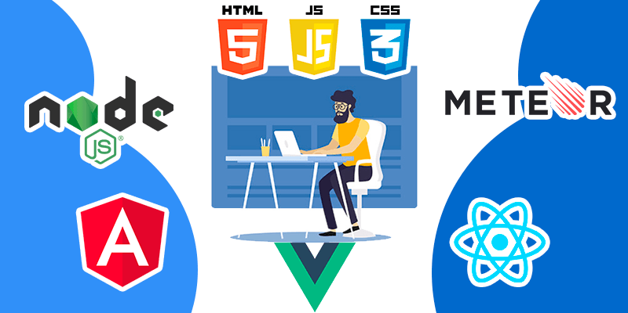
Technologies Used
We have used backend technologies to design the user interface and to connect it to the server and making things available to the public on Internet.
The technologies used are:
ReactJS
MongoDB
ExpressJS

Slide 5

ReactJS
To start building a user interface, you might use React, a JavaScript library for building flexible and reusable components.
React.js is now one of the most battle-tested and matured frontend frameworks in the world and express.js is it's counterpart among backend/server frameworks.
It lets you compose complex UIs from small and isolated pieces of code called “components” that are easy to render on the browser. We have designed different components for our application where the related content renders like Header component, UploadForm component, Gallery component, etc.

Slide 6

MongoDB
MongoDB is a general purpose, document-based, distributed database built for modern application developers and for the cloud era.
MongoDB is a document database, which means it stores data in JSON-like documents. We believe this is the most natural way to think about data, and is much more expressive and powerful than the traditional row/column model.
We need to deploy it on the cloud to make it work so we use MongoDB Atlas for this, that stores the images on the cloud or when online.

Slide 7

ExpressJS
Express is a minimal and flexible Node.js web application framework that provides a robust set of features for web and mobile applications.
It is flexible as there are numerous modules available on npm, which can be directly plugged into Express.
It makes it easier to organize your application’s functionality with middle ware and routing; it adds helpful utilities to Node.js HTTP objects; it facilitates the rendering of dynamic HTTP objects.

Slide 8

User Interface Implementations

Slide 9
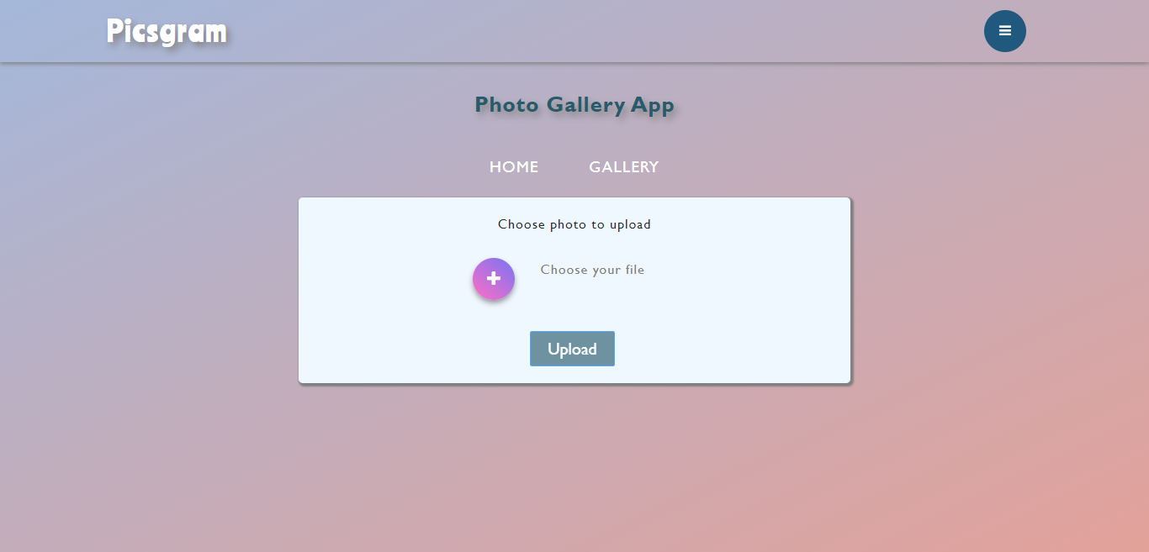
This is the main page of the application where user can upload an image on clicking the plus symbol and also show the name of the file in the sidebar, after which the upload button is enabled and the image will get uploaded with a notification.

Slide 10
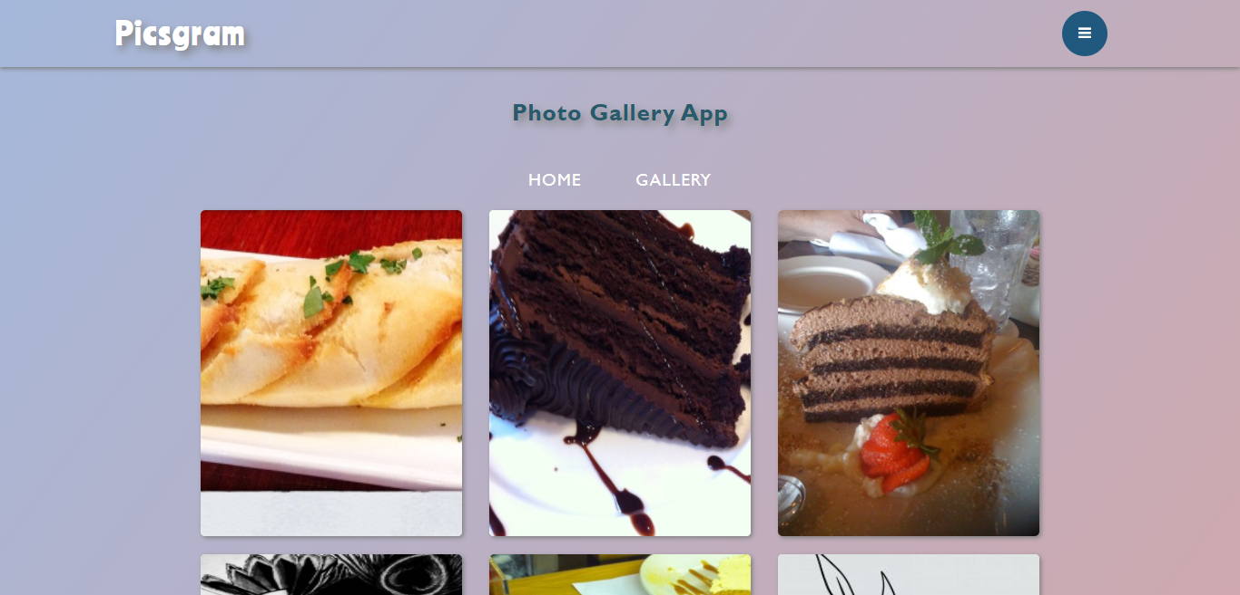
This is the Gallery page where the user can see the uploaded image in the form of cards. Firstly, these images are stored in the database and then after rendered on the screen for viewing.

Slide 11
Thank You

